Slide 1
Relational DataBase Management Systems (RDBMS)
Bouchiba Soulayma

Slide 2
Relational Database Management Systems (RDBMS):
A Relational Database Management System (RDBMS) provides a foundation for numerous apps and services. Technologically, RDBMS are considered primeval. However, the strong theoretical foundation of relational database technology has kept it pertinent in a volatile industry.
This is why even non-relational databases include RDBMS-like features, such as the SQL interface in Hadoop. Some popular examples of relational databases include Microsoft SQL Server and MySQL, which may store employee records, customer records, and various other business information.

Slide 3

What is a Database Management System?
A database management system (DBMS) is software designed to store, retrieve, and manage data in databases. The most prevalent DBMS system is the RDBMS.
The full form of RDBMS is Relational Database Management System.
Now that it is clear what a database management system is let’s learn about the relational database management solution.

Slide 4
Before creating these tables, the RDBMS must check the following constraints:
Primary keys : this identifies each row in the table. One table can only contain one primary key. The key must be unique and without null values.
Foreign keys : this is used to link two tables. The foreign key is kept in one table and refers to the primary key associated with another table.
Not null : this ensures that every column does not have a null value, such as an empty cell.
Check : this confirms that each entry in a column or row satisfies a precise condition and that every column holds unique data.
Data integrity : the integrity of the data must be confirmed before the data is created.

Slide 5
Assuring the integrity of data includes several specific tests, including entity, domain, referential and user-defined integrity. Entity integrity confirms that the rows are not duplicated in the table. Domain integrity makes sure that data is entered into the table based on specific conditions, such as file format or range of values. Referential integrity ensures that any row that is re-linked to a different table cannot be deleted. Finally, user-defined integrity confirms that the table will satisfy all user-defined conditions.

Slide 6
Advantages of relational database management system
The use of an RDBMS can be beneficial to most organizations; the systematic view of raw data helps companies better understand and execute the information while enhancing the decision-making process.
The use of tables to store data also improves the security of information stored in the databases. Users are able to customize access and set barriers to limit the content that is made available. This feature makes the RDBMS particularly useful to companies in which the manager decides what data is provided to employees and customers.

Slide 7
Furthermore, RDBMSes make it easy to add new data to the system or alter existing tables while ensuring consistency with the previously available content. Other advantages of the RDBMS include: Flexibility : updating data is more efficient since the changes only need to be made in one place. Maintenance : database administrators can easily maintain, control and update data in the database. Backups also become easier since automation tools included in the RDBMS automate these tasks. Data structure : the table format used in RDBMSes is easy to understand and provides an organized and structural manner through which entries are matched by firing queries.

Slide 8
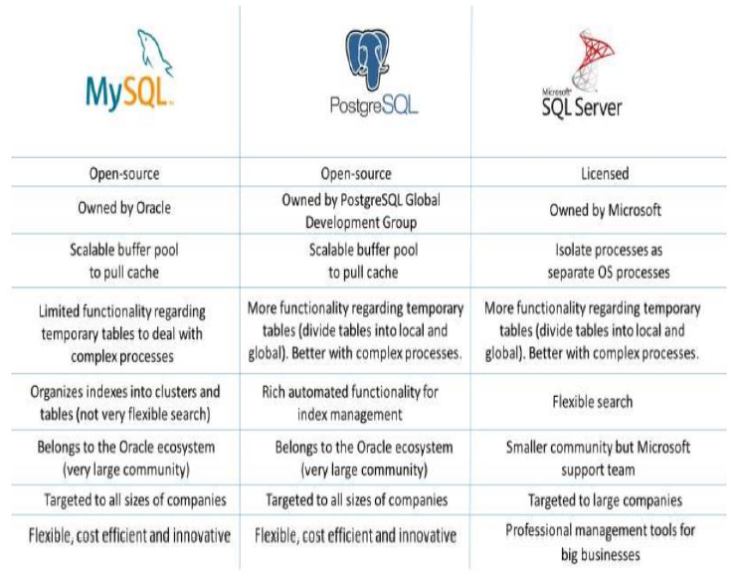
Comparison between the three RDBMS

